Slide 1
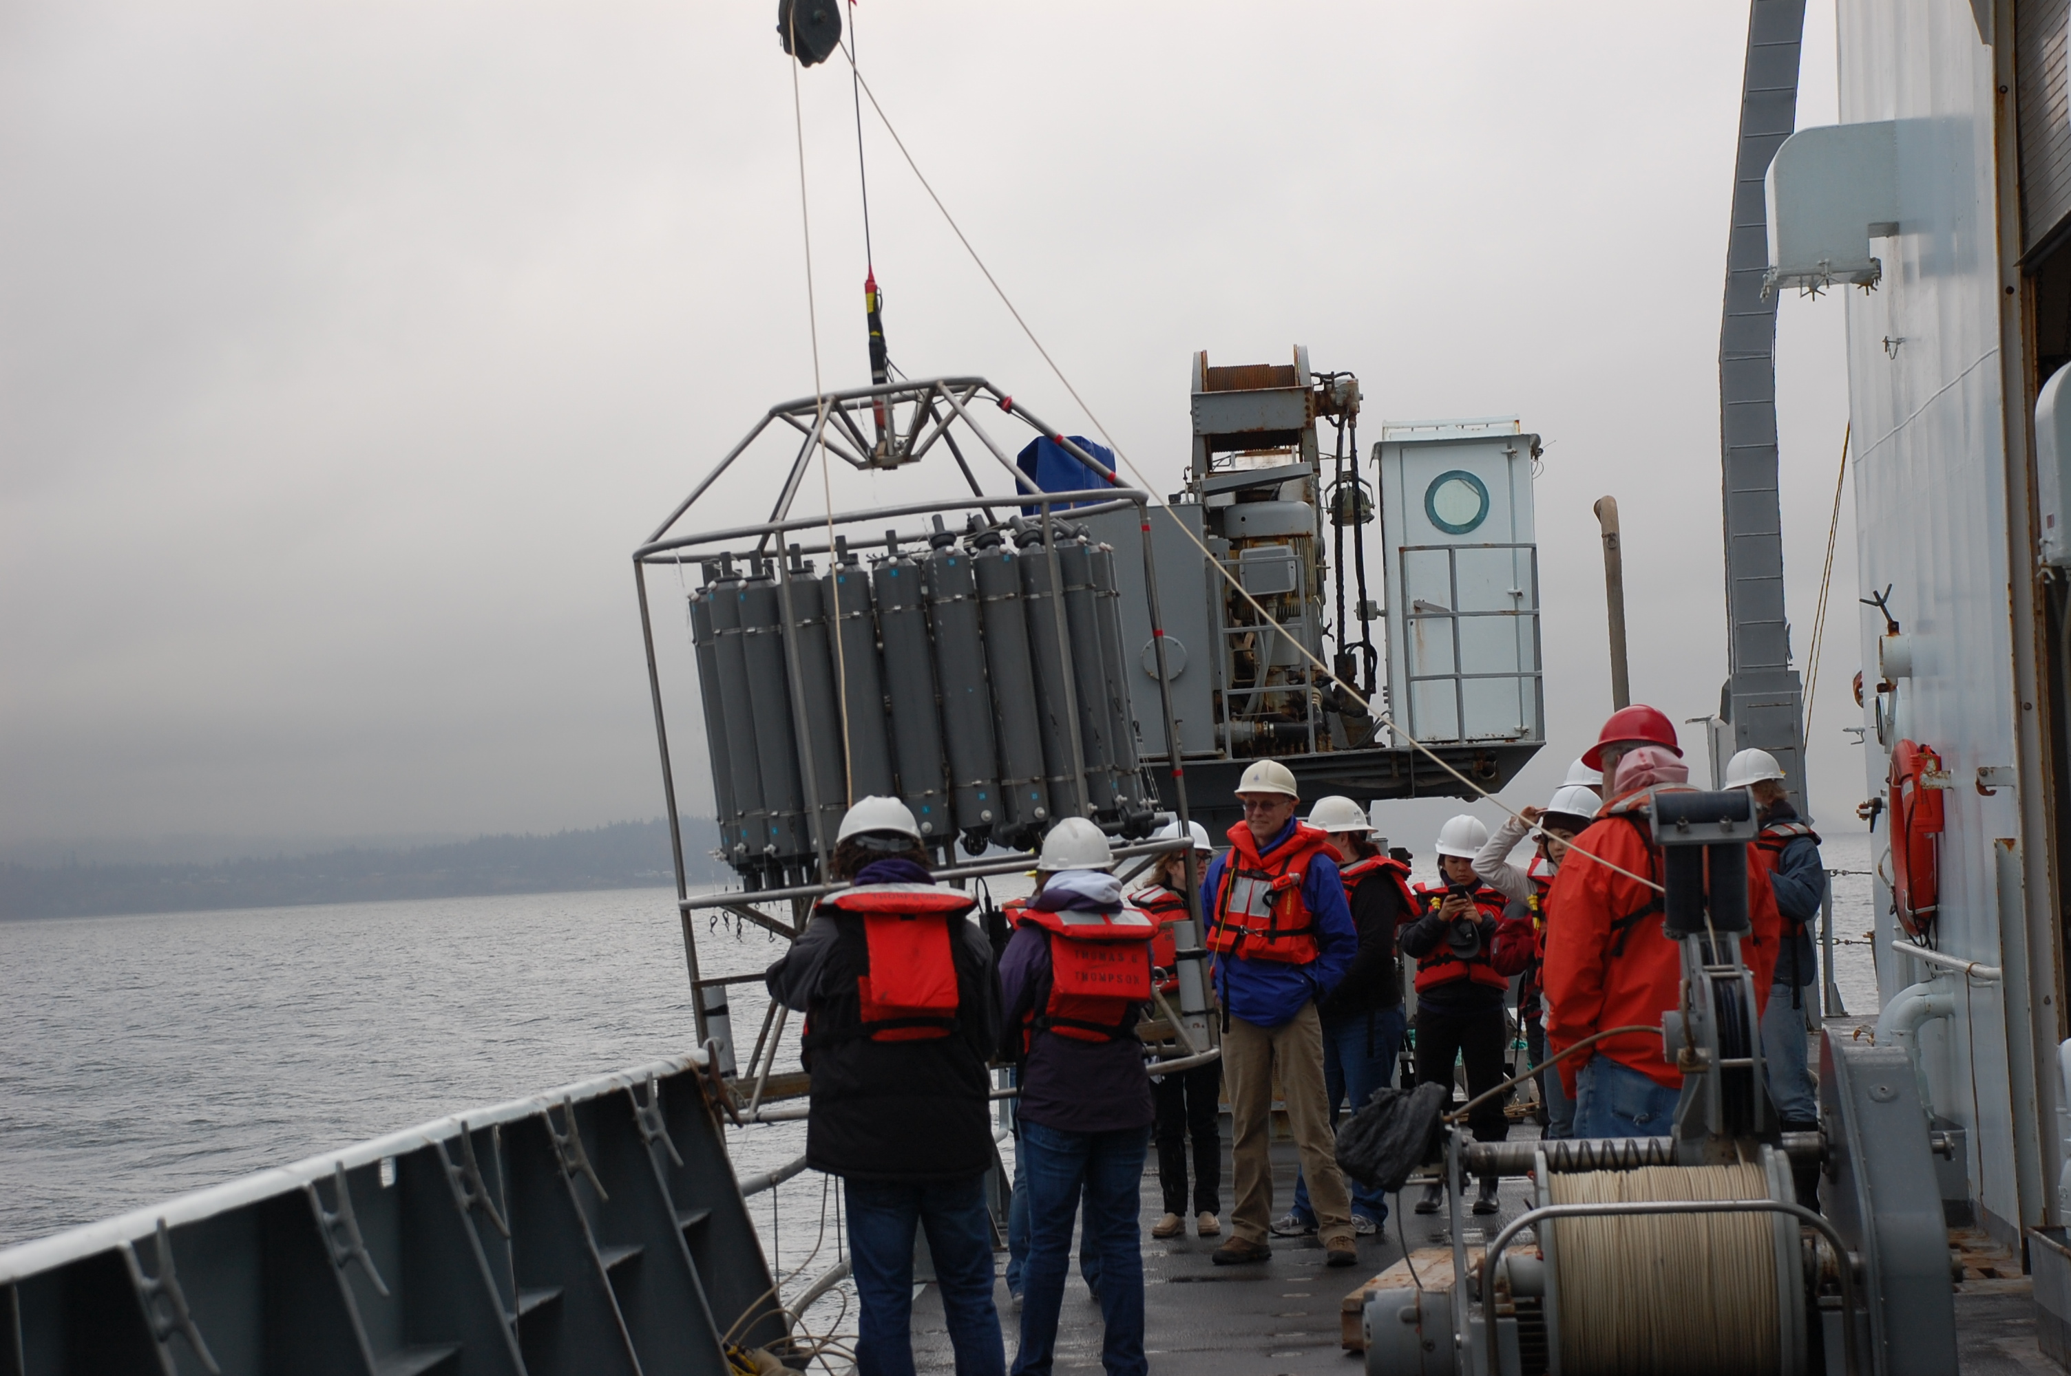
Thompson Cruise Recap

Slide 2
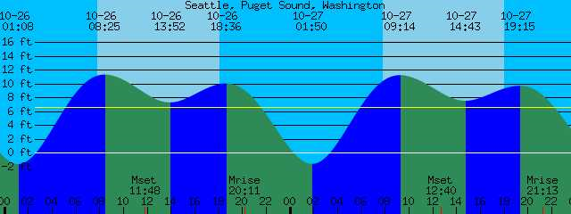
Cruise Track

Slide 3
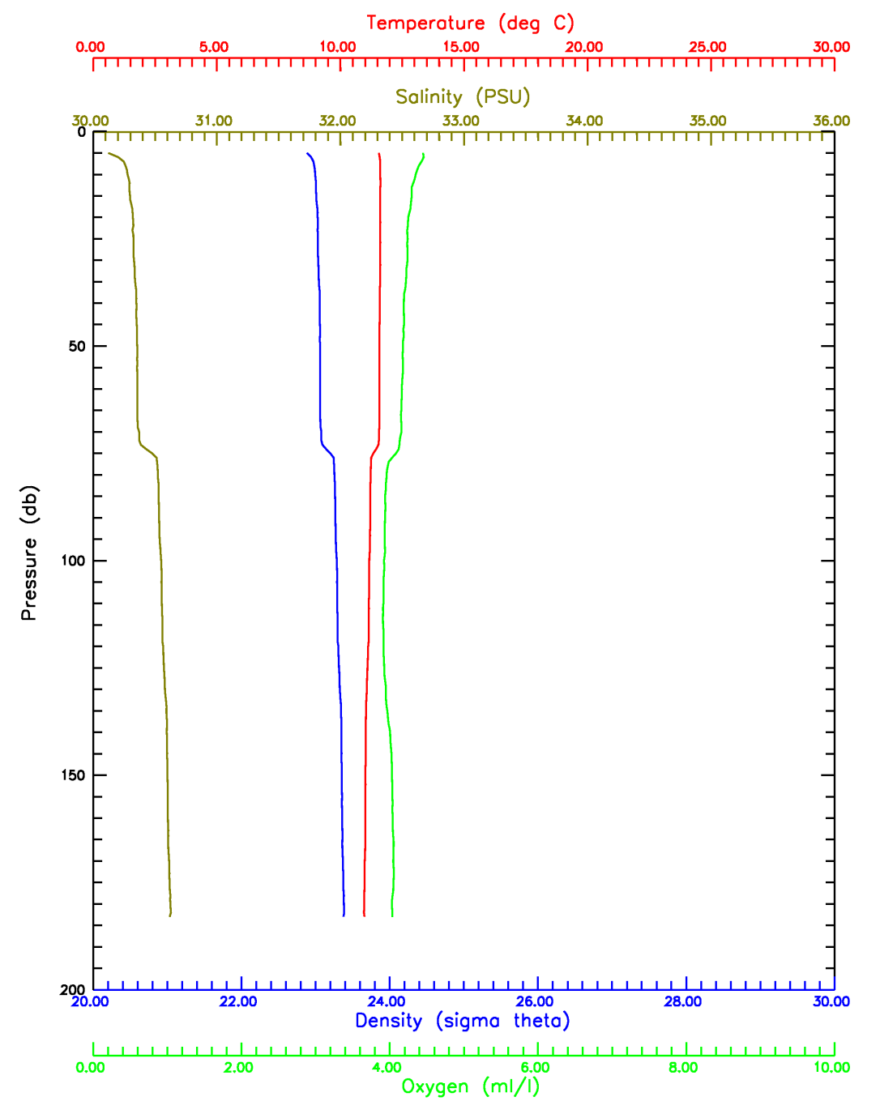
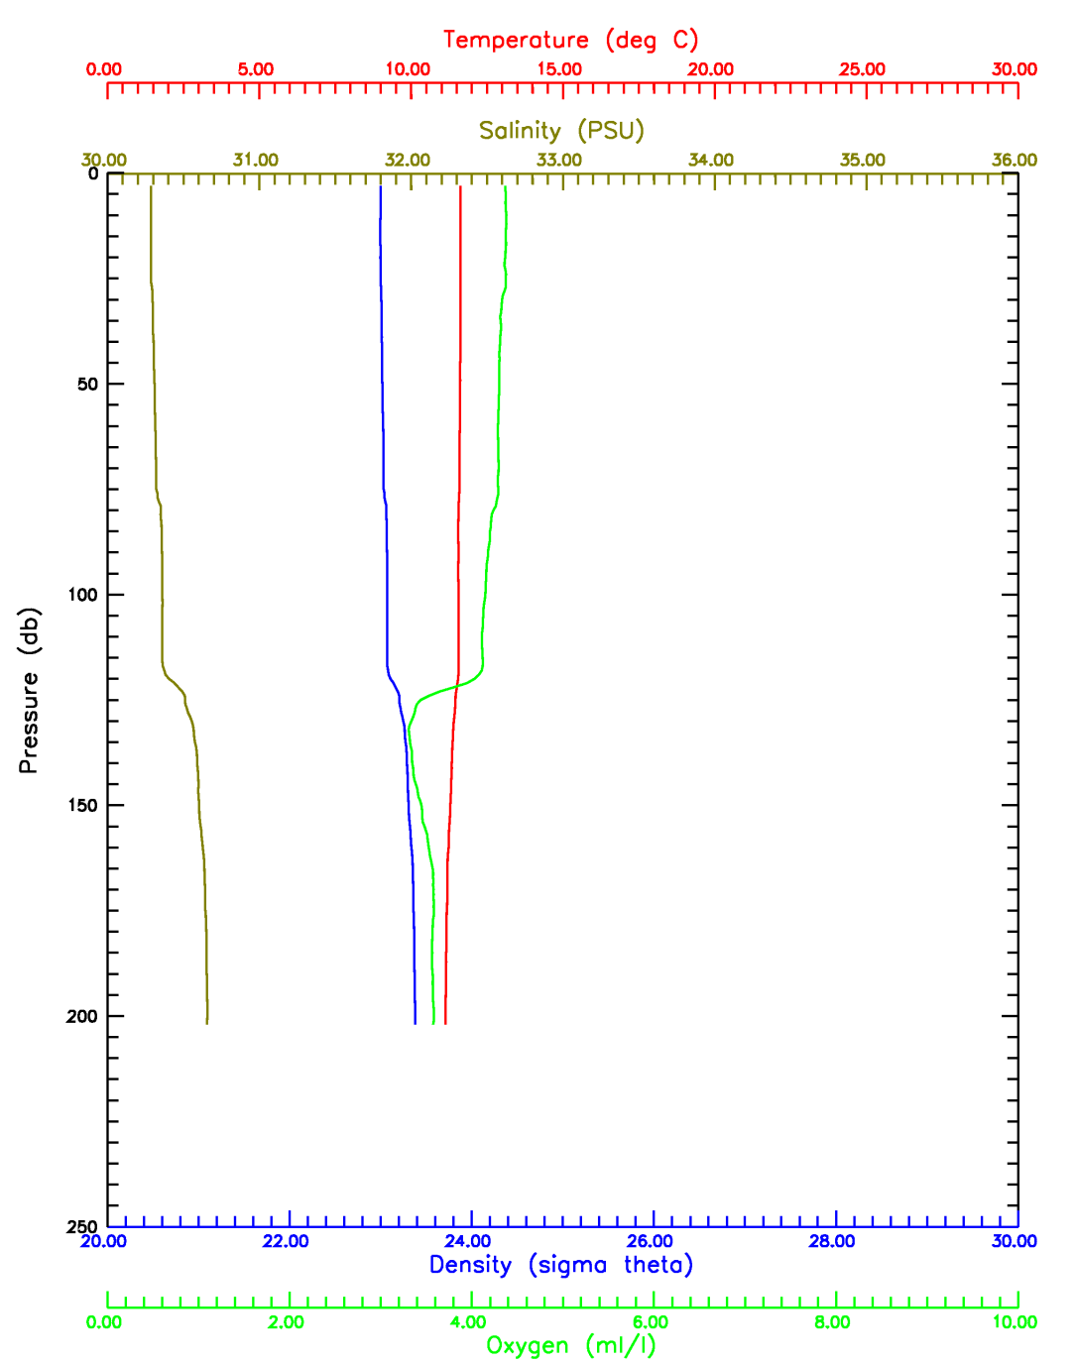
CTD data
Station 5
Station 28

Slide 4
CTD Data

Slide 5
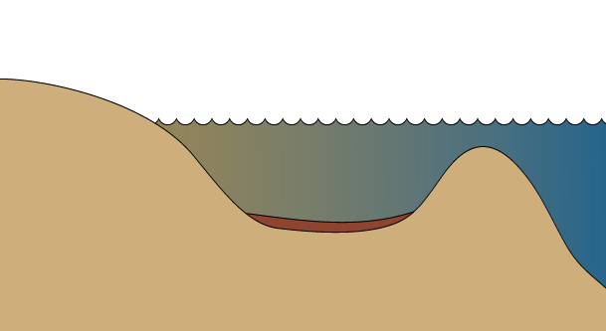
Estuarine Circulation
Fresh River Input
Upwelling
Entrainment/Mixing
Saline Ocean Input
Notes:
First I’ll describe the basics of physical estuarine mixing.
Hood Canal is your basic fjord like estuary, characterized by a shallow sill at the entrance, which causes mixing and flushing rates to be extremely slow
Fresh and marine water input creates strong stratification of water column—top is chemically distinct from bottom
Tidal movement promotes entrainment and mixing
Other way of mixing is wind driven upwelling

Slide 6
What affects O2 concentrions?
CO₂ + H₂O = CH₂O + O₂
N-Limited
CO₂
O₂
Notes:
Like most estuaries, HC is N limited and light limited during the winter
What are the sources of N to the system?
Once we add the limiting nutrient, primary production or an algal bloom occurs

Slide 7
What affects Hood Canal Hypoxia?
Extent of hypoxia depends on: 1) algal bloom magnitude (nutrients/light)
2) extent of deep water upwelling (wind)
Low O₂
Notes:
Layer of low DO bottom water develops.
If we had a larger than usual bloom or more mixing this line starts to move up, until it reaches the surface—fishkill
Extent of depletion of DO and depth of this layer depends on 1 and 2
It’s likely that sunlight availability and marine N input have remained relatively constant.
Input from watershed although largely natural may be changing to a small extent – urbanization and red alder trees, which outcompete conifers after clearing
These small changes in watershed loading may push O2 levels over the “tipping point” making a bad year deadly.

Slide 8
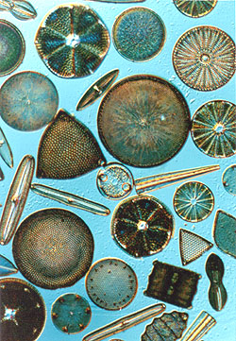
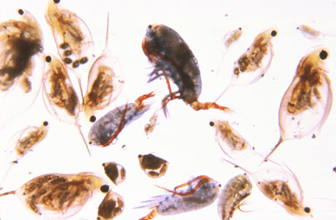
Zooplankton Diel migration

